Slide 1
Defining Broadvision “community” segments
Segments should be:
  Reachable
  MECE, but not required (and often not achievable)
Basis for segmentation must be extensible to products and content elements
  i.e., if income is important for customer segmentation, each product must be tagged as appropriate for for a given income group
Important to directly understand customer’s buying decision variables
  basis for segmentation can change depending on merchandise being purchased (i.e., financial products depend on lifestage while groceries depend on family needs or price sensitivity)

Slide 2
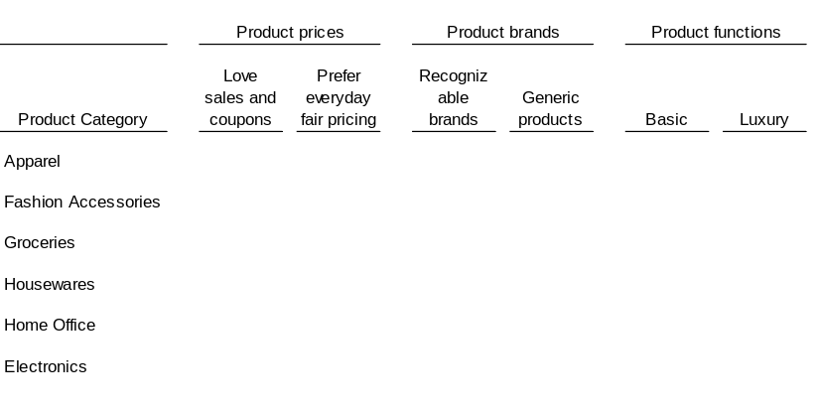
Use psychographic or socio-demographic* segmentation variables?
Psychographic questionnaire
Socio-demographic questionnaire
1. Please select your shopping preferences on pricing, brands, and product functions in each of the following categories:
1. What is your gender?
male
female
2. In which age group do you fall?
18 to 25
45 to 54
25 to 34
55 to 64
Privacy
35 to 44
65+
3. What is your household income bracket?
Under $18K
$40 to 55K
$19 to 25K
$56 to 70K
3. How often do you shop T&K?
$26 to 39K
Over $70K
Weekly: at least 3 times per month
4. In which group do you fall?
1-2 times per month
Single
Once every 2 to 3 months
Married, no children
Once every 4 to 6 months
Once a year
Married with children
Less than once a year, never
* Adapted from PwC consumer surveys

Slide 3
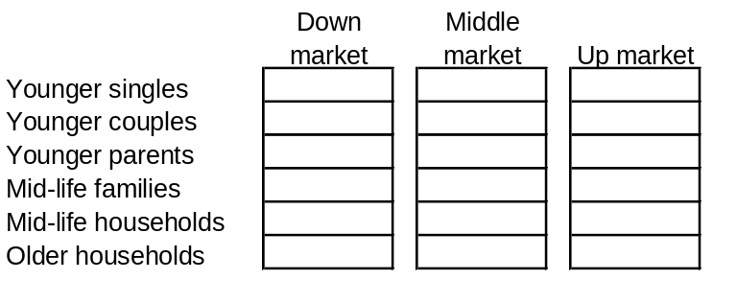
Possible segmentation output from either set of variables
Psychographic
Socio-demographic*
Sales Lovers
Prefer sales and coupon items
Buy branded goods when on sale, generics otherwise
Rarely buy luxury items
Splurgers
Buy on EDFP basis, rarely use coupons
Prefer brands over generics
Tend to splurge on luxury items in each category
Trusting Folk
Will use coupons as available, less than average
Prefer brands, never buy generics
Purchase basic goods, rarely splurge
Practicalists
Use coupons and buy sales items with average frequency
Equally use brands and generics
Purchase basic goods, rarely splurge
* Source: PwC Shopper Update

Slide 4
Psychographic variables tend to map to products better, but...
Psychographic variables
Products from T&K
Socio-demographic variables
On sale or EDFP
Martha Stewart stoneware
Gender
Palm V
Income
Brand or generic
Australian wine
Age
Family
Luxury or basic
Blank VHS tapes
Bed linens

Slide 5
… using the segments themselves can be more rewarding
Psychographic segments
Products from T&K
Socio-demographic segments
Sales lovers
Martha Stewart stoneware
Young mid-tier singles
Palm V
Middle age low tier families
Splurgers
Australian wine
Mature high tier couples
Trusting folk
Young mid tier families
Blank VHS tapes
Practicalists
Bed linens
Is it realistic to expect site merchant(s) to assign 20+ socio-demographic segments to each product/content element?

Slide 6
Best option is to combine the two segmentation variable sets
Sales Lovers
Splurgers
Prefer sales and coupon items
Buy branded goods when on sale, generics otherwise
Rarely buy luxury items
All families in middle and down markets
Buy on EDFP basis, rarely use coupons
Prefer brands over generics
Tend to splurge on luxury items in each category
Young couples and singles in middle and up markets
Trusting Folk
Practicalists
Will use coupons as available, less than average
Prefer brands, never buy generics
Purchase basic goods, rarely splurge
Families and households in middle and up markets
Use coupons and buy sales items with average frequency
Mostly purchase generics
Purchase basic goods, rarely splurge

Slide 7
Segmentation using both psychographic and socio-demographic approach
Benefits
Uses both demographic and psychographic elements
Allows merchant to tag product and content elements with appropriate segment codes rather than segmentation variables
  more intuitive and natural
Reflects real-life segmentation exercises and retailer core segments
Allows for category-specific “community” creation
Drawbacks
Not MECE
  Non-core segments are not captured or targeted
  Customer could switch segments depending on trip needs (can be accounted for via Net Perceptions)

